Slide 1

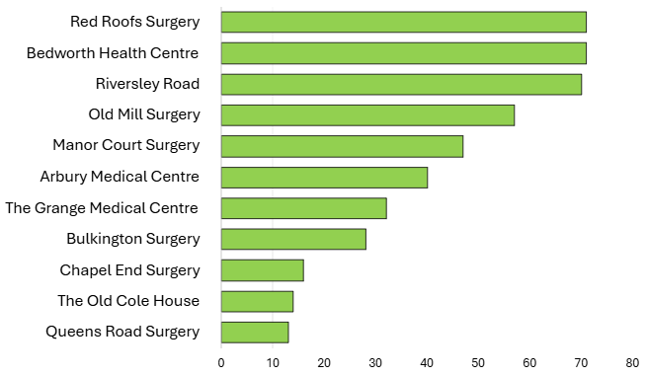
SPLW Referrals Quarter 3 - 2025/2026
Practice Name | No. Referrals | Referral Percentage | Representative Percentage
Bedworth Health Centre | 71 | 15.47% | 20.79%
Red Roofs Surgery | 71 | 15.47% | 13.19%
Riversley Road | 70 | 15.25% | 6.61%
Old Mill Surgery | 57 | 12.42% | 13.10%
Manor Court Surgery | 47 | 10.24% | 8.15%
Arbury Medical Centre | 40 | 8.71% | 9.49%
The Grange Medical Centre | 32 | 6.97% | 11.79%
Bulkington Surgery | 28 | 6.10% | 5.71%
Chapel End Surgery | 16 | 3.49% | 4.81%
The Old Cole House | 14 | 3.05% | 3.68%
Queens Road Surgery | 13 | 2.83% | 2.67%
SPLW Referrals – Total 459
GP Surgery
Number of Referrals

Slide 2
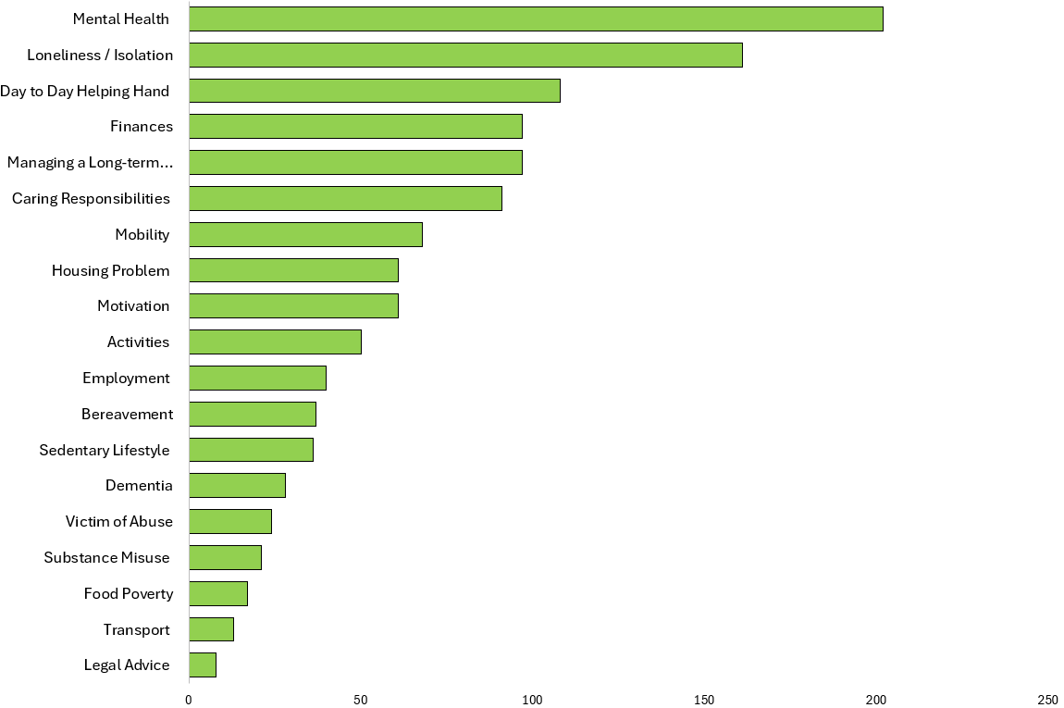
SPLW Top Referral Reasons Quarter 3 - 2025/2026
SPLW Top Referral Reasons
Reasons for Referral | Number | Percentage
Mental Health | 202 | 14.84%
Loneliness / Isolation | 161 | 11.83%
Day to Day Helping Hand | 108 | 7.94%
Managing a Long-term Health Condition | 97 | 7.13%
Finances | 97 | 7.13%
Caring Responsibilities | 91 | 6.69%
Mobility | 68 | 5.00%
Motivation | 61 | 4.48%
Housing Problem | 61 | 4.48%
Activities | 50 | 3.67%
Employment | 40 | 2.94%
Bereavement | 37 | 2.72%
Sedentary Lifestyle | 36 | 2.65%
Dementia | 28 | 2.06%
Victim of Abuse | 24 | 1.76%
Substance Misuse | 21 | 1.54%
Food Poverty | 17 | 1.25%
Transport | 13 | 0.96%
Legal Advice | 8 | 0.59%
SPLW Top Referral Reasons
Referral Reason
Number of Referrals

Slide 3
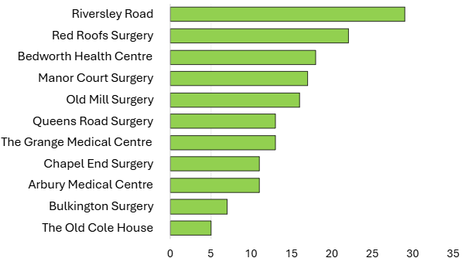
HWBC Referrals Quarter 3 - 2025/2026
Practice Name | No. Referrals | Referral Percentage | Representative Percentage
Riversley Road | 29 | 17.90% | 6.61%
Red Roofs Surgery | 22 | 13.58% | 13.19%
Bedworth Health Centre | 18 | 11.11% | 20.79%
Manor Court Surgery | 17 | 10.49% | 8.15%
Old Mill Surgery | 16 | 9.88% | 13.10%
The Grange Medical Centre | 13 | 8.02% | 11.79%
Queens Road Surgery | 13 | 8.02% | 2.67%
Arbury Medical Centre | 11 | 6.79% | 9.49%
Chapel End Surgery | 11 | 6.79% | 4.81%
Bulkington Surgery | 7 | 4.32% | 5.71%
The Old Cole House | 5 | 3.09% | 3.68%
HWBC Referrals – Total 162
GP Surgery
Number of Referrals

Slide 4
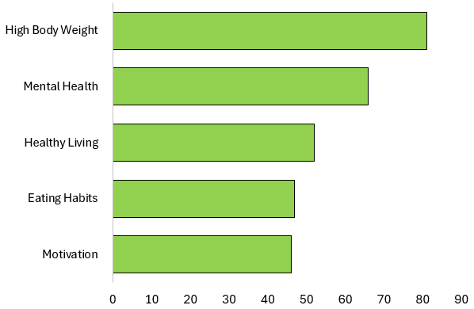
HWBC Top Referral Reasons Quarter 3 - 2025/2026
HWBC Top Referral Reasons
Reasons for Referral | Number | Percentage
High Body Weight | 81 | 15.40%
Mental Health | 66 | 12.55%
Healthy Living | 52 | 9.89%
Eating Habits | 47 | 8.94%
Motivation | 46 | 8.75%
HWBC Top Referral Reasons
Referral Reason
Number of Referrals

Slide 5
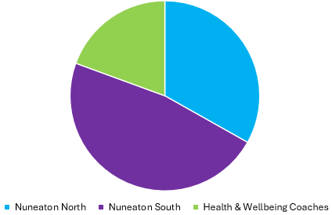
Current Waiting Lists
Nuneaton North | 116
Nuneaton South | 166
Health & Wellbeing Coaches | 68

Slide 6
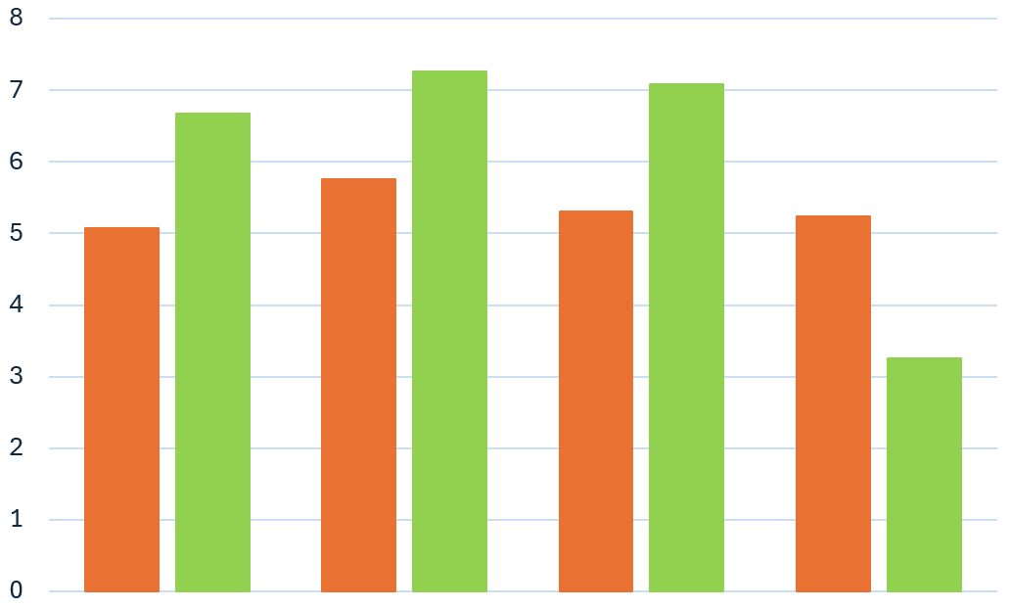
SPLW & HWBC ONS4 Average Improvement Scores Quarter 3 - 2025/2026
Average Improvement in Wellbeing Based on ONS4
 | Average Baseline | Average Follow Up | % Average Improvement
Life Satisfaction | 5.08 | 6.68 | 31.5%
Worthwhile | 5.76 | 7.26 | 26.0%
Happiness | 5.30 | 7.08 | 33.6%
Anxiety | 5.24 | 3.26 | 37.8%
Average Score
Life Satisfaction
Worthwhile
Happiness
Anxiety
Overall Average Improvement in Wellbeing
32%
Wellbeing Questions
*Anxiety scoring is inverted with a lower score indicating an improvement.
These improvement scores are based on 4 questions which are scored from 1 – 10 which are asked at the initial assessment and upon discharge.
1. Overall, how satisfied are you with your life nowadays?
2. Overall, to what extent do you feel the things you do in your life are worthwhile?
3. Overall, how happy did you feel yesterday?
4. On a scale where 0 is “not at all anxious” and 10 is “completely anxious”, overall,
how anxious did you feel yesterday?

Slide 7
Feedback from our Partners, Patients and Groups…
“I would like to take this time to send feedback about the service and care we received from the Social Prescribing team at Nuneaton and Bedworth PCN.
From the moment we initially spoke to the Social Prescriber, we knew they had an absolute source of knowledge, relief and support. They have gone above and beyond at every level. It has been really hard for us looking after our mother in law following a bad fall and an Alzheimer's diagnosis and the Social Prescriber has given us so much support. Knowing what is available, what we can do to help and sometimes just listening through my frustrations. Thank you so much from the bottom of my heart…”
“I have had a really supportive journey with the Health & Wellbeing Coach, they have been incredibly understanding and were able to provide ongoing support to me to help me feel good in my body, through healthy eating and exercise. This process has been very pleasant, and I am grateful to them, making this process a lot nicer to go through. Through this incredible support, I have been able to loose weight and feel comfortable with my body and understand it’s ok to have bad days.”
Miss A, 21
“Thank you for all the support, it has been amazing!
I really appreciate the fact that the Healh & Wellbeing Coach dedicated time to sit with me in my own home and talk about my goals and make notes.
If they had told me what to do, I would not have done it, so by allowing me to set activity goals which fit in with my lifestyle and do not feel like a chore is invaluable."
Mrs C, 89 & Daughter-in-law
“My Son has a more positive outlook on his future, and are both extremely thankful of the support the Social Prescriber has into place for the pair of us.
I feel like so much weight has been lifted off my shoulders and I am extremely positive for what the future holds for me and my son.”
Mrs B, 62
Mr E, 32 & Mother

Slide 8
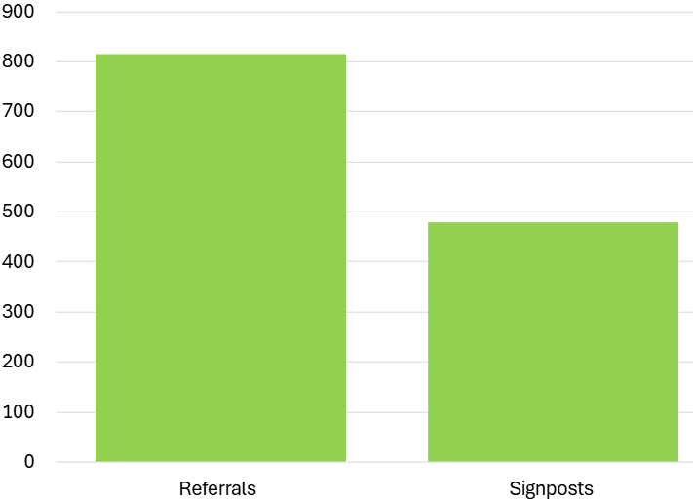
Top 25 Services Referred to by SPLW’s / HWBC’s in Quarter 3 - 2025/2026
Service and organisation name | Total
Citizens Advice Bureau & Law Centre - Health Justice Partnership Programme | 76
Volunteer Friends | 65
Warwickshire County Council - Adult Social Care | 54
N&B PCN Mental Health Practitioners | 47
N&B PCN Seated Exercise Class | 46
N&B PCN Walk and Talk | 36
Talking Therapies Coventry and Warwickshire | 32
Active Sky Blues 12 week programme | 31
Carers Trust | 27
Mind - Coventry and Warwickshire | 24
Pure Physiotherapy - Pain Management | 23
HEART - N&B Borough Council | 23
P3 | 22
GP Services - Nuneaton and Bedworth | 21
WorkWell Coventry & Warwickshire | 20
Recovery and Wellbeing Academy | 20
N&B PCN Walking Football | 18
N&B PCN Dieticians | 18
N&B PCN Care Coordinators | 18
KeyRing | 18
Mary Ann Evans | 18
The Trussell Trust - Food Bank | 18
N&B PCN & Warwickshire Wildlife Trust - Gardening for Wellbeing Taster Sessions | 16
Mental Health Access Hub | 16
N&B PCN Pain Café | 16
Total Number of Referrals / Signposts made to Community / Statutory Services by SPLW’s / HWBC’s During Interventions
Number of Referrals / Signposts
814
478
Signposts are made when either there is no referral process for a service or it is felt appropriate to empower a patient who is sufficiently able to make contact with a service themselves .

