Slide 1

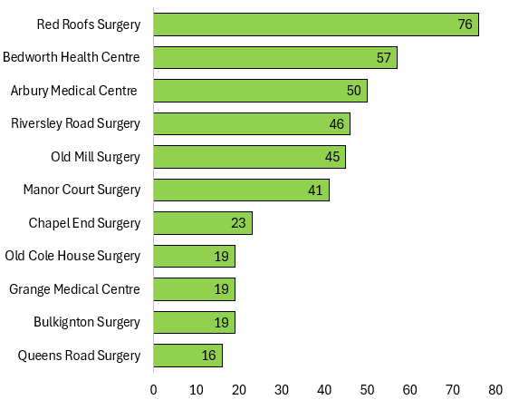
SPLW Referrals Quarter 1 - 2026/2027
Practice Name | No. Referrals | Referral Percentage | Representative Percentage
Red Roofs Surgery | 76 | 18.49% | 12.80%
Bedworth Health Centre | 57 | 13.87% | 20.76%
Arbury Medical Centre | 50 | 12.17% | 9.42%
Riversley Road Surgery* | 46 | 11.19% | 6.99%
Old Mill Surgery | 45 | 10.95% | 13.09%
Manor Court Surgery | 41 | 9.98% | 8.23%
Chapel End Surgery | 23 | 5.60% | 4.94%
Bulkington Surgery | 19 | 4.62% | 5.94
Grange Medical Centre | 19 | 4.62% | 11.58%
Old Cole House Surgery | 19 | 4.62% | 3.62
Queens Road Surgery | 16 | 3.89% | 2.63%
SPLW Referrals – Total 411
GP Surgery
Number of Referrals

Slide 2
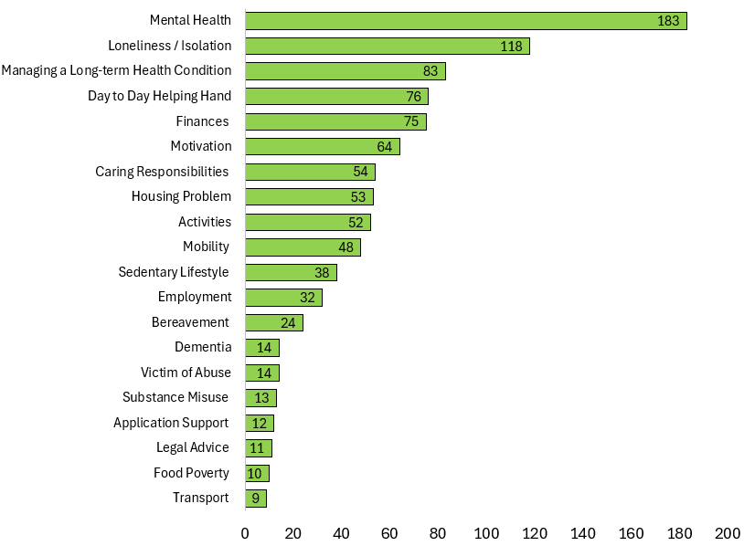
SPLW Top Referral Reasons Quarter 1 - 2026/2027
SPLW Top Referral Reasons
Reasons for Referral | Number | Percentage
Mental Health | 183 | 18.62%
Loneliness / Isolation | 118 | 12.00%
Managing a Long-term Health Condition | 83 | 8.44%
Day to Day Helping Hand | 76 | 7.73%
Finances | 75 | 7.63%
Motivation | 64 | 6.51%
Caring Responsibilities | 54 | 5.49%
Housing Problem | 53 | 5.39%
Activities | 52 | 5.29%
Mobility | 48 | 4.88%
Sedentary Lifestyle | 38 | 3.87%
Employment | 32 | 3.26%
Bereavement | 24 | 2.44%
Victim of Abuse | 14 | 1.42%
Dementia | 14 | 1.42%
Substance Misuse | 13 | 1.32%
Application Support | 12 | 1.22%
Legal Advice | 11 | 1.12%
Food Poverty | 10 | 1.02%
Transport | 9 | 0.92%
SPLW Top Referral Reasons
Referral Reason
Number of Referrals

Slide 3
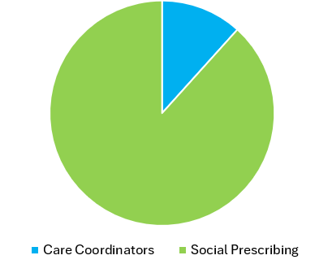
SPLW Referrals Redirected to Care Coordinators Quarter 1 - 2026/2027
11.92%
88.08%
Care Coordinators | 49
Social Prescribing | 362

Slide 4
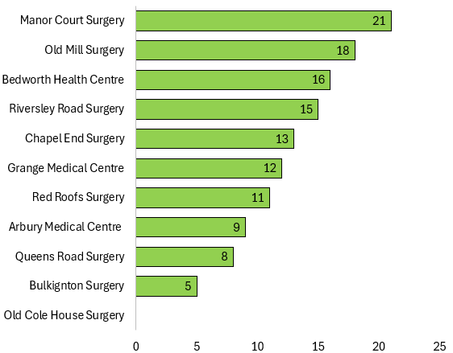
HWBC Referrals Quarter 1 - 2026/2027
Practice Name | No. Referrals | Referral Percentage | Representative Percentage
Manor Court Surgery | 21 | 16.41% | 8.23%
Old Mill Surgery | 18 | 14.06% | 13.09%
Bedworth Health Centre | 16 | 12.50% | 20.76%
Riversley Road Surgery* | 15 | 11.72% | 6.99%
Chapel End Surgery | 13 | 10.16% | 4.94%
Grange Medical Centre | 12 | 9.38% | 11.58%
Red Roofs Surgery | 11 | 8.59% | 12.80%
Arbury Medical Centre | 9 | 7.03% | 9.42%
Queens Road Surgery | 8 | 6.25% | 2.63%
Bulkington Surgery | 5 | 3.91% | 5.94
Old Cole House Surgery | 0 | 0.00% | 3.62
HWBC Referrals – Total 128
GP Surgery
Number of Referrals

Slide 5
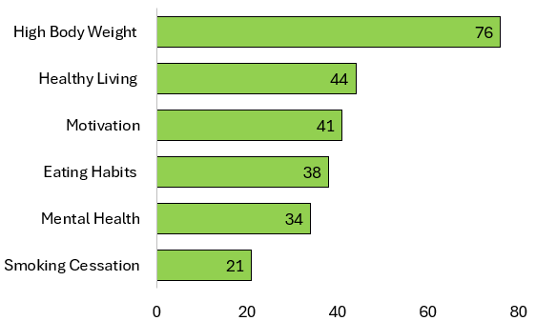
HWBC Top Referral Reasons Quarter 1 - 2026/2027
HWBC Top Referral Reasons
Reasons for Referral | Number | Percentage
High Body Weight | 76 | 29.92%
Healthy Living | 44 | 17.32%
Motivation | 41 | 16.14%
Eating Habits | 38 | 14.96%
Mental Health | 34 | 13.39%
Smoking Cessation | 21 | 8.27%
HWBC Top Referral Reasons
Referral Reason
Number of Referrals

Slide 6
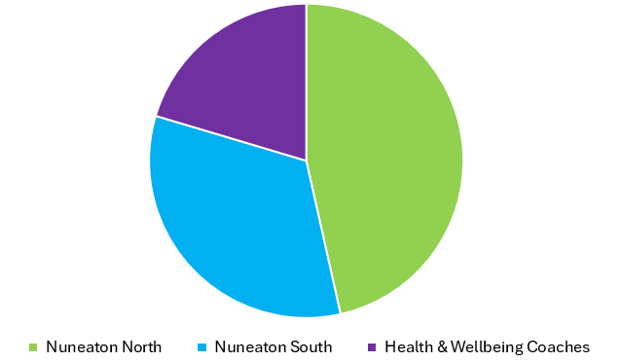
Current Waiting Lists
Nuneaton North | 76
Nuneaton South | 67
Health & Wellbeing Coaches | 33

Slide 7
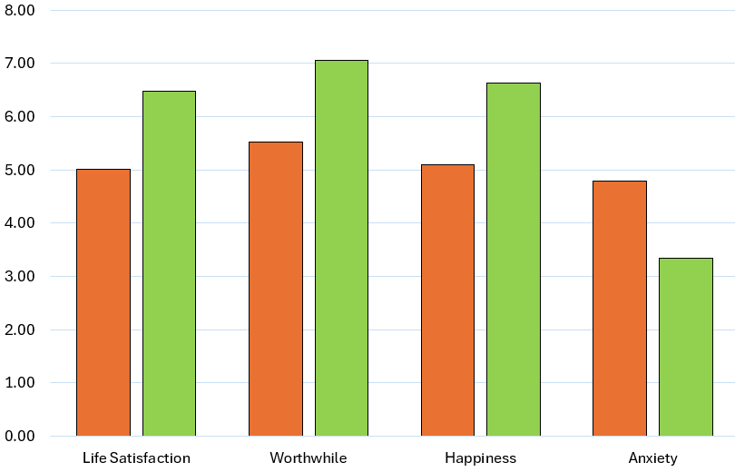
SPLW & HWBC ONS4 Average Improvement Scores Quarter 1 - 2026/2027
Average Improvement in Wellbeing Based on ONS4
 | Average Baseline | Average Follow Up | % Average Improvement
Life Satisfaction | 5.01 | 6.48 | 29%
Worthwhile | 5.53 | 7.05 | 27%
Happiness | 5.10 | 6.63 | 30%
Anxiety | 4.79 | 3.35 | 30%
Average Score
Overall Average Improvement in Wellbeing
29%
Wellbeing Questions
*Anxiety scoring is inverted with a lower score indicating an improvement.
These improvement scores are based on 4 questions which are scored from 1 – 10 which are asked at the initial assessment and upon discharge.
1. Overall, how satisfied are you with your life nowadays?
2. Overall, to what extent do you feel the things you do in your life are worthwhile?
3. Overall, how happy did you feel yesterday?
4. On a scale where 0 is “not at all anxious” and 10 is “completely anxious”, overall,
how anxious did you feel yesterday?

Slide 8
Feedback from our Partners, Patients and Groups…
“Thank you for all the support, you have been so helpful and supportive and I have always felt very comfortable with you. I am saddened that the referral needs to be closed however all of the help and support has made a big difference and been a huge help.”
“Thank you so much for the help and support you’ve provided to my dad and the assistance you gave me with applying for the NHS funding.
You can’t imagine what a massive weight this is off our minds, to know he has been accepted for the funding for care”
“Like I say the support is just amazing and the other people who attend will support each other. It makes me so happy on a Friday, and it gives me something to look forward to. It is something that I need in my life”
“The Health & Wellbeing Coach has been really supportive and encouraging, it has helped me achieve my goal of walking 3 kilometers on my treadmill in 50 minutes which I now do 6 days a week thank you so much”
Mr A, 76
Walking Football Participant
Mrs B, 34
Mrs C, 74
“This group has really encouraged me to get out the house and I have only ever missed 1 week which was when my child was getting her jabs. Its great that I can talk to other parents and a great way to get active and get steps in instead of sitting on the sofa all day“
“I have found a new passion for swimming and have been going 3/4 times a week.
Before speaking to you I would never have got into a pool. Now it is a habit"
“The support has been very good, without it I was lost. I don't like asking for help, but I realised help is out there for a reason. I am grateful you were there to help when I needed it. Thanks for the help”
“I enjoy both sides of the session, I haven’t been a dancer but enjoy the routine to music, the exercise class is lighter and allows me to still do exercise keeping my body moving”
Buggy Talk Participant
Mrs E, 60
Seated Exercise Participant
Miss D, 22

Slide 9
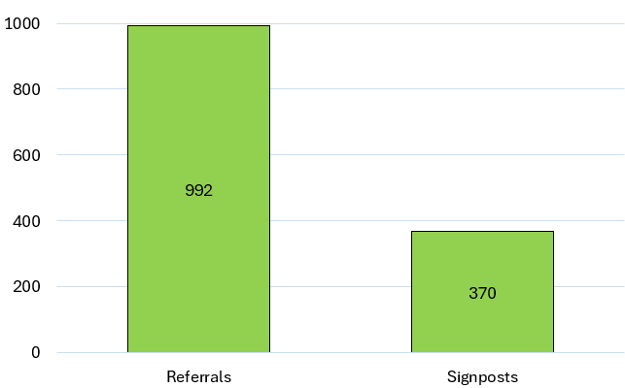
Top 25 Services Referred to by SPLW’s / HWBC’s in Quarter 1 - 2026/2027
Service | Total
Citizens Advice Bureau | 102
N&B PCN Care Coordinators | 84
Talking Therapies Coventry and Warwickshire | 54
Volunteer Friends | 48
PCN Mental Health Practitioners | 45
Pure Physiotherapy - Pain Management | 44
Warwickshire County Council - Adult Social Care | 39
Recovery and Wellbeing Academy | 37
P3 | 34
Age UK Coventry and Warwickshire | 32
HEART - N&B Borough Council | 31
Carers Trust Warwickshire | 29
N&B PCN Walk and Talk | 27
N&B PCN Health & Wellbeing Coaches | 26
Nuneaton & Bedworth Borough Council | 25
Active Sky Blues 12 Week Programme | 24
ISPA - Adult out of Hospital Services | 24
KeyRing | 24
Everyone Active | 23
Mind - Coventry and Warwickshire | 23
N&B PCN Seated Exercise Class | 21
Family Information Service (FIS) | 18
Community Autism Support Service (CASS) | 17
N&B PCN Dieticians | 16
Total Number of Referrals / Signposts made to Community / Statutory Services by SPLW’s / HWBC’s During Interventions
Number of Referrals / Signposts
Signposts are made when either there is no referral process for a service or it is felt appropriate to empower a patient who is sufficiently able to make contact with a service themselves .

